Slide 1



Coupling structural optimization and trajectory optimization methods in additive manufacturing
Mathilde Boissier
PhD advisors: Grégoire Allaire, Christophe Tournier
Notes:
Mathilde Boissier
Part of PhD work
Gregoire allaire Christophe tournier
Metallic AM + part shape opt and path shape opt to improve the process

Slide 2
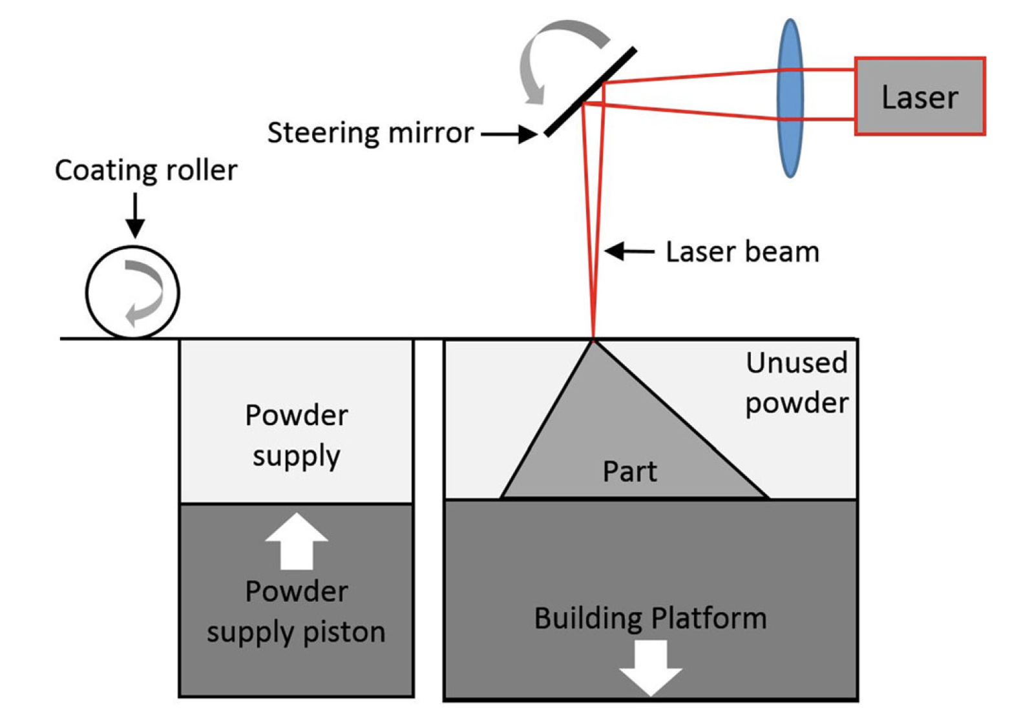
Powder Bed Fusion (PBF)
Bikas, H., P. Stavropoulos, and G. Chryssolouris, Additive Manufacturing Methods and Modelling Approaches: A Critical Review In: The International Journal of Advanced Manufacturing Technology 83.1-4 (2016), pp. 389–405.
https://www.youtube.com/watch?v=yiUUZxp7bLQ
Notes:
Focusing on PBF processes
Part built layer by layer
For each layer, metallic powder spread on the already built part
Heat source travels along prescribed path Melting the powder
When cooling down, the powder solidifies
Video to illustrates
Powder and melts and powder and melts
For each layer, heat source travels along the path
Path important: determines the temperature distribution and impacts the final quality of the object

Slide 3

Notion of “good path”
$$a^{(a)}$$
Parallel
Zigzag
Contour
Spiral
Medial Axis Transform
Fractal
Hybrid
(a) D. Ding, Z. Pan, D. Cuiuri, H. Li, and S. van Duin, Advanced design for additive manufacturing: 3d slicing and 2d path planning, New trends in 3d printing, (2016), pp. 1–23.
Notes:
What paths now in use in industry and looked into with the articles?
Mainly based on patterns with adaptations like cutting object in cell and affect pattern to each
Each of them induces defects but no information on which one to choose for each shape to build.

Slide 4
Objectives of this work
How to use shape optimization to facilitate the generation of “good” scanning path?
Objectives:
Optimization of the path “from scratch”
Concurrent optimization between part shape and scanning path
Bibliography:
    T.M. ALAM, Some optimal control problem of partial differential equations and applications to the selective laser melting process (SLM), PhD thesis, Université Polytechnique Hauts-de-France, 2020
    Q. Chen, J. Liu, X. Liang, and A. C. To, A level-set based continuous scanning path optimization method for reducing residual stress and deformation in metal additive manufacturing, Computer Methods in Applied Mechanics and Engineering, 360 (2020), p. 112719.
    M. Boissier, G. Allaire, C. Tournier, Scanning path optimization using shape optimization tools, Structural and Multidisciplinary Optimization, 61:6, pp. 2437-2466, 2020
Notes:
Question that started this phd: are there shapes better than others to induce good paths?
Are there criteria on the shape helpful?
Objectives:
develop algo to optimize path from scratch on different shapes to get intuition
Use this code to couple it with part shape optimization to understand how each impacts the other
Bibliography on path optimization: two recent works
Tonia maria ALAM: phd work, optimizing the path using optimal control
J.Liu and team: have been working for some time on this – optimize to control the quality using the inherent strain method

Slide 5
Overview
    Modelling assumptions
    Scanning path optimization
    Part optimization
    Concurrent optimization

Slide 6
Overview
    Modelling assumptions
    Scanning path optimization
    Part optimization
    Concurrent optimization

Slide 7

Modelling the scanning process
$$a^{(a)}$$
Microscale modelling:
- accurate model for the change of state and melting pool
- 4 states considered: powder, solid, liquid and gaseous
Macroscale modelling:
simplified model without accurate computation of the change of state and melting pool
2 states considered: powder, solid
STAKES AT A MACROSCOPIC SCALE
thermo-mechanics: thermal expansion, residual stresses, solidification of a layer
kinematics: minimal execution time
$(a)$ T. DebRoy, H. Wei, J. Zuback, T. Mukherjee, J. Elmer, J. Milewski, A. M. Beese, A. Wilson-Heid, A. De, and W. Zhang, Additive manufacturing of metallic components–process, structure and properties, Progress in Materials Science, 92 (2018), pp. 112–224.
Notes:
Optimizing requires simulating and thus a model
Complicated process: correct modelling requires 4 states + fluid mechanics and non linear complicated equations -> computationnaly expensive
Simplifications -> choice of a macroscale model
2 states and brutal change of phase from one to another
Still can control the thermomechanics and especially thermal expansion+residual stresses

Slide 8




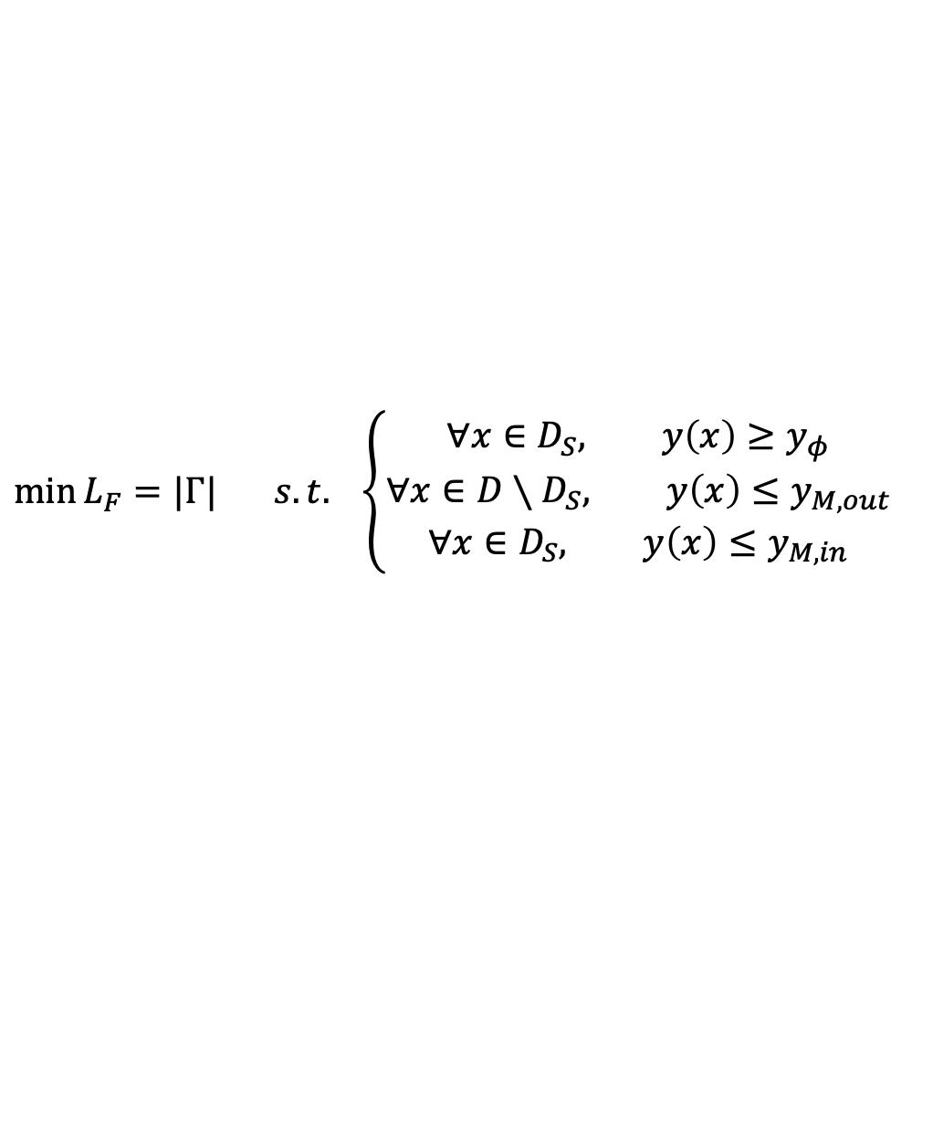



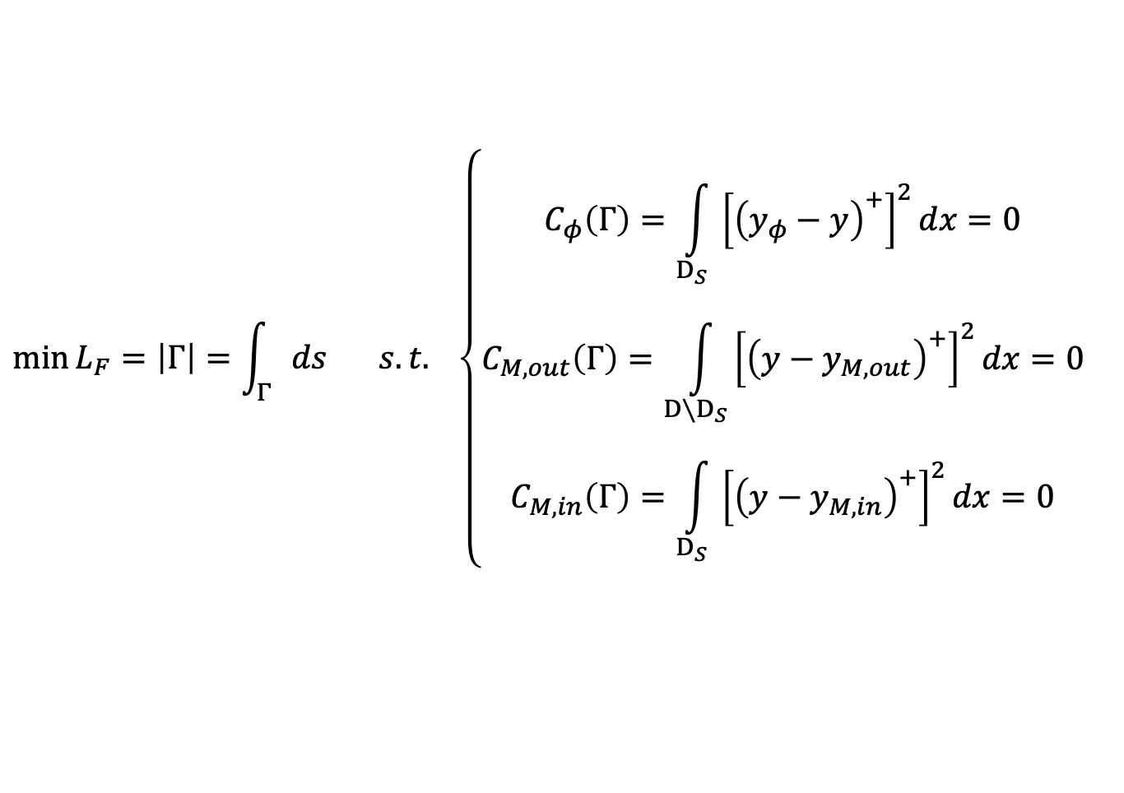
Steady model
The whole source is switched on at once
Dirac function of the path $Γ$:
$$q=Pχ_{Γ}$$
$$\left\{\begin{aligned}−∇\left(λ∇p\right)+βp=2\left[{\left(y_{φ}−y\right)}^{+}𝕝_{D_{S}}−{\left(y−y_{M,in}\right)}^{+}𝕝_{D_{S}}−{\left(y−y_{M,out}\right)}^{+}𝕝_{{D∖D}_{S}}\right] \\ λ∂_{n}p=0\end{aligned}\right.$$
Temperature equation:
$−∇\left(λ∇y\right)+β\left(y−y_{ini}\right)=Pχ_{Γ}$,
$$x∈D$$
$$x∈∂D$$
$λ∂_{n}y=0$,
$$\min{L_{F}=\left|Γ\right|=\int_{Γ}{ds}} s.t. \left\{\begin{aligned}C_{φ}\left(Γ\right)=\int_{D_{S}}{{\left[{\left(y_{φ}−y\right)}^{+}\right]}^{2}dx}=0 \\ C_{M,out}\left(Γ\right)=\int_{{D∖D}_{S}}{{\left[{\left(y−y_{M,out}\right)}^{+}\right]}^{2}dx}=0 \\ C_{M,in}\left(Γ\right)=\int_{D_{S}}{{\left[{\left(y−y_{M,in}\right)}^{+}\right]}^{2}dx}=0\end{aligned}\right.$$
Optimization problem:
$$\min{L_{F}=|Γ|} s.t. \left\{\begin{aligned}∀x∈D_{S}, y\left(x\right)≥y_{φ} \\ ∀x∈D∖D_{S}, y\left(x\right)≤y_{M,out} \\ ∀x∈D_{S}, y\left(x\right)≤y_{M,in}\end{aligned}\right.$$
Notes:
Further simplifications with a steady model in which the whole source is switched on at once and intuitively corresponds to a hot thread put on the powder.
Thransformtation of the source
Transformation of the heat eq
Transformation of the optimization problem

Slide 9
Overview
    Modelling assumptions
    Scanning path optimization
    Object’s shape optimization
    Concurrent optimization

Slide 10
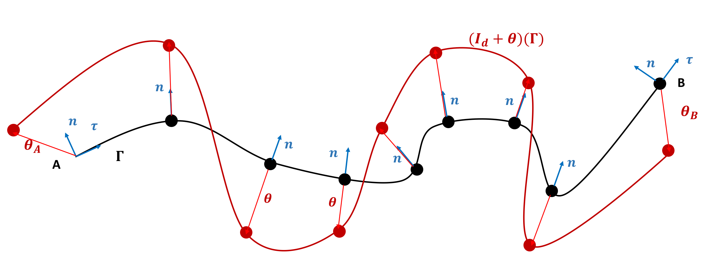

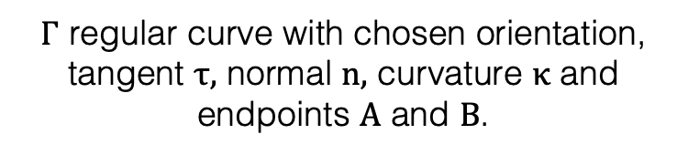

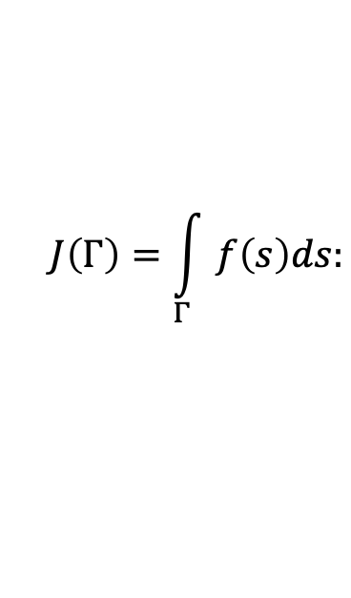
Optimization algorithm
Gradient computation: shape differentiation theory (Differentiate and then discretize)
$Γ$ regular curve with chosen orientation, tangent $τ,$ normal $n,$ curvature $κ$ and endpoints $A$ and $B$.
$$J\left(Γ\right)=\int_{Γ}{f\left(s\right)ds:}$$
$$DJ\left(Γ\right)(θ)=\int_{Γ}{\left(∂_{n}f+κf\right)θ⋅nds+f\left(B\right)θ\left(B\right)⋅τ\left(B\right)−f\left(A\right)θ\left(A\right)⋅(A)}$$
Shape derivative of
Gradient descent:
$$J\left(Γ^{n+1}\right)=J\left(Γ^{n}\right)+DJ\left(Γ^{n}\right)\left(θ\right)+o\left(θ\right)$$
$θ$ chosen such that $J\left(Γ^{n+1}\right)≤J(Γ^{n})$
Combined with an Augmented Lagrangian method to deal with the constraints
A. Henrot and M. Pierre, Shape variation and optimization, EMS Tracts in Mathematics, European Mathematical Society (EMS), Zürich, 2018.
Notes:
From the model, the objective is now to optimize the path
Gradient computations using shape optimization theory
Evaluation of the problem’s evolution when moving the path with respect to a vector field theta
General formulation for shape derivative
Gradient descent on this -> correctly choosing the vector field theta
Constraints dealt with an Augmented Lagrangian method

Slide 11
Different initializations – Aluminum ($λ=130Wm^{−1}K^{−1})$
Zigzag 3
Zigzag 6
Zigzag 9
Zigzag 12
Zigzag 15
9 lines
Spiral
2 lines contour
Results really dependent on the initialization
Numerical values mainly gathered in one zone
Zigzag 9 and 12 interesting at an industrial point of view
Contour 1
Contour 2
Contour 3
Contour 4
Notes:
Numerical tests:
Aluminum high conductivity
Objective is to melt the square – colors: green to orange. Red is too hot, blue is unmelted (out of the square must remain blue)
Starting from different optimizations
Ends up with different results
Hoever, numerical results gathered (abscissa length ordinate constraint)
Theus many local minima
+ zigzag 9 could be easily tried and corroborated observations

Slide 12
Different initializations – Titanium ($λ=15Wm^{−1}K^{−1})$
Zigzag 6
Zigzag 9
Zigzag 12
Zigzag 18
Zigzag 21
12 lines
Spiral
2 lines contour
Low conductivity complicates the optimization
Numerical values gathered
Illustrates the problem of local minima
Contour 1
Contour 2
Contour 4
Contour 5
Notes:
T[ai]tinium: conductivity much lower: much more complicated
Constraints not perfectly satisfied (blue and red + intersection)-> Augmented Lagrangian could be improved
Intersection-> adding criterion or modify the maximum temperature constraint
Yet, quantitative results gatheres -> local minima

Slide 13
Different initializations – Aluminum ($λ=130Wm^{−1}K^{−1})$
2 lines contour
Initialization 1
Initialization 2
Initialization 3
Results really dependent on the initialization
Correct adaptation to the shape if allowed by the conductivity => shape thickness
Notes:
Test of different shapes
Two first are ok
Last complicated: bar too thin to be well melted

Slide 14
Different initializations – Titanium ($λ=15Wm^{−1}K^{−1})$
2 lines contour
Initialization 1
Initialization 2
Initialization 3
Low conductivity complicates the optimization
Results really dependent on the initialization
Correct adaptation to the shape if allowed by the conductivity => shape thickness
Notes:
Last not bad: conductivity lower
But first more complicated: large space to fill womplicated with low conductivity

Slide 15
Overview
    Modelling assumptions
    Scanning path optimization
    Part optimization
    Concurrent optimization

Slide 16
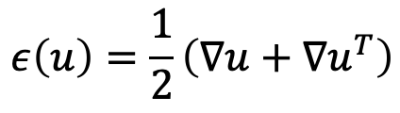


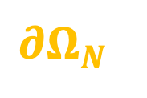





















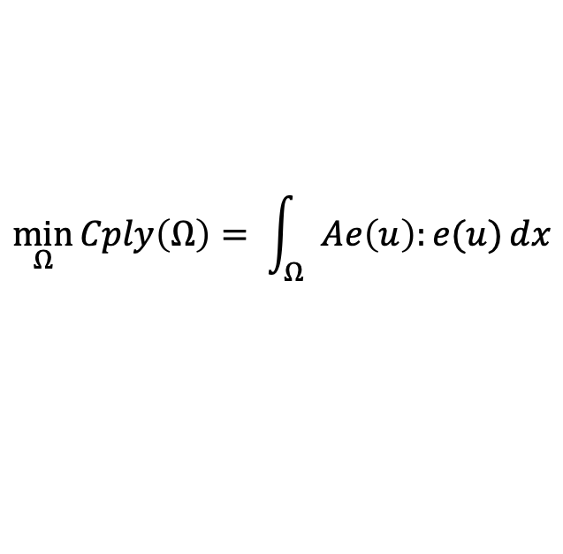




Part optimization
$$\min_{Ω}{Cply\left(Ω\right)= \int_{Ω}{Ae\left(u\right):e(u)}dx}$$
$$\int_{Ω}{dx}=V_{target}$$
such that
$∂Ω_{D}$
$$D$$
$$\left\{\begin{aligned}k \\ k \\ \begin{matrix}k \\ k \\ k\end{matrix}\end{aligned}\right.$$
$$−div\left(Aε\left(u\right)\right)=0,$$
$$x∈Ω,$$
$∂Ω_{F}$
$$Aε\left(u\right)⋅n=g,$$
$$x∈∂Ω_{N},$$
$$D$$
$$Ω$$
$∂Ω_{N}$
$$Aε\left(u\right)⋅n=0,$$
$$x∈∂Ω_{F},$$
$$u=0,$$
$$x∈∂Ω_{D}.$$
$$g$$
$$ε\left(u\right)=\frac{1}{2}\left(∇u+∇u^{T}\right)$$
$∂Ω_{D}$
$$D$$
$A$, Hooke tensor
Gradient computation: shape differentiation theory (Differentiate and then discretize)
Combined with an Augmented Lagrangian method and a dichotomy to deal with the volume constraint
$$a^{(a)}$$
Numerical representation: level set
$$\left\{\begin{matrix}\begin{matrix}f \\ f\end{matrix} \\ f \\ f\end{matrix}\right.$$
$$ψ\left(x\right)<0,$$
$$x∈Ω,$$
$$ψ\left(x\right)=0,$$
$$x∈∂Ω,$$
$$ψ\left(x\right)>0,$$
$$x∈D∖\overline{Ω}.$$
G. Allaire, F. Jouve, and A.-M. Toader, Structural optimization using sensitivity analysis and a level-set method, J. Comput. Phys., 194 (2004), pp. 363–393.
Notes:
Leave path opt on one side and now focus on part optimization only
Here: optimize complicance under exact volume constraint
Elactisity problem
Algorithm: ALM and dichotomy to exactly satisfy the volume constraint
+ level set representation

Slide 17
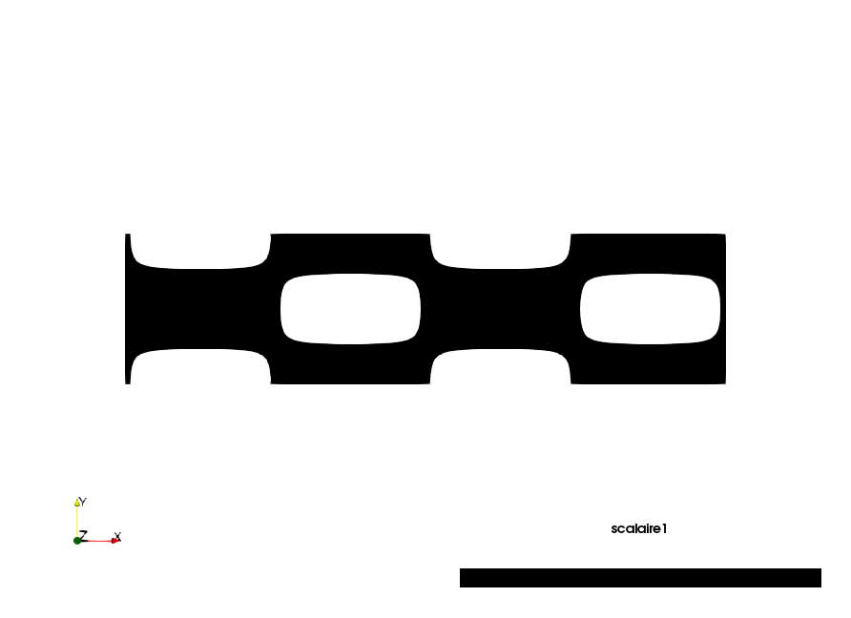

Results – cantilever
$$V_{tar}=1.1V^{0}$$
Notes:
Result to obtain two different volumes + video

Slide 18
Overview
    Modelling assumptions
    Scanning path optimization
    Partoptimization
    Concurrent optimization

Slide 19
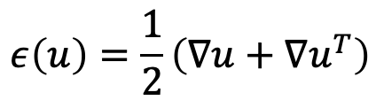














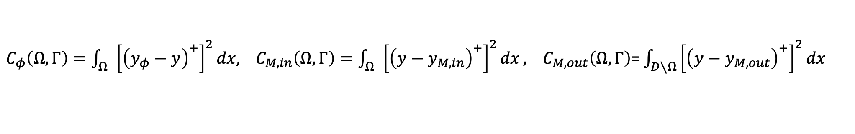

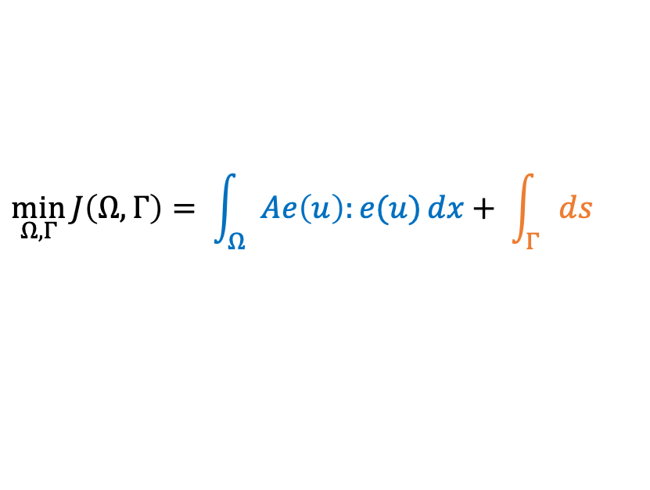




Coupling part and path optimizations
$$\left\{\begin{aligned}k \\ k \\ \begin{matrix}k \\ k \\ k\end{matrix}\end{aligned}\right.$$
$$\int_{Ω}{dx}=V_{target}$$
$$\min_{Ω,Γ}{J\left(Ω,Γ\right)= \int_{Ω}{Ae\left(u\right):e(u)}dx+ \int_{Γ}{ds}}$$
$$C\left(Ω,Γ\right)=C_{φ}\left(Ω,Γ\right)+C_{M,in}\left(Ω,Γ\right)+C_{M,out}\left(Ω,Γ\right)=0$$
$$Cply$$
$$L_{F}$$
$C_{φ}\left(Ω,Γ\right)=\int_{Ω}{{\left[{\left(y_{φ}−y\right)}^{+}\right]}^{2}dx}$, $C_{M,in}\left(Ω,Γ\right)=\int_{Ω}{{\left[{\left(y−y_{M,in}\right)}^{+}\right]}^{2}dx}, C_{M,out}\left(Ω,Γ\right)$= $\int_{D∖Ω}{{\left[{\left(y−y_{M,out}\right)}^{+}\right]}^{2}dx}$
$$\left\{\begin{aligned}k \\ k \\ \begin{matrix}k \\ k \\ k\end{matrix}\end{aligned}\right.$$
$$−div\left(Aε\left(u\right)\right)=0,$$
$$x∈Ω,$$
$∂Ω_{D}$
$$D$$
$$Aε\left(u\right)⋅n=g,$$
$$x∈∂Ω_{N},$$
$$Aε\left(u\right)⋅n=0,$$
$$x∈∂Ω_{F},$$
$∂Ω_{F}$
$$u=0,$$
$$x∈∂Ω_{D}.$$
$$Ω$$
$$D$$
$∂Ω_{N}$
$A$, Hooke tensor
$$ε\left(u\right)=\frac{1}{2}\left(∇u+∇u^{T}\right)$$
$$g$$
$$\left\{\begin{aligned}−∇\left(λ∇p\right)+βp=2\left[{\left(y_{φ}−y\right)}^{+}𝕝_{D_{S}}−{\left(y−y_{M,in}\right)}^{+}𝕝_{D_{S}}−{\left(y−y_{M,out}\right)}^{+}𝕝_{{D∖D}_{S}}\right] \\ λ∂_{n}p=0\end{aligned}\right.$$
$$D$$
$−∇\left(λ∇y\right)+β\left(y−y_{ini}\right)=Pχ_{Γ}$,
$$x∈D,$$
$∂Ω_{D}$
$λ∂_{n}y=0$,
$x∈∂D$.
Notes:
Coupling both
Objective function mixing both

Slide 20
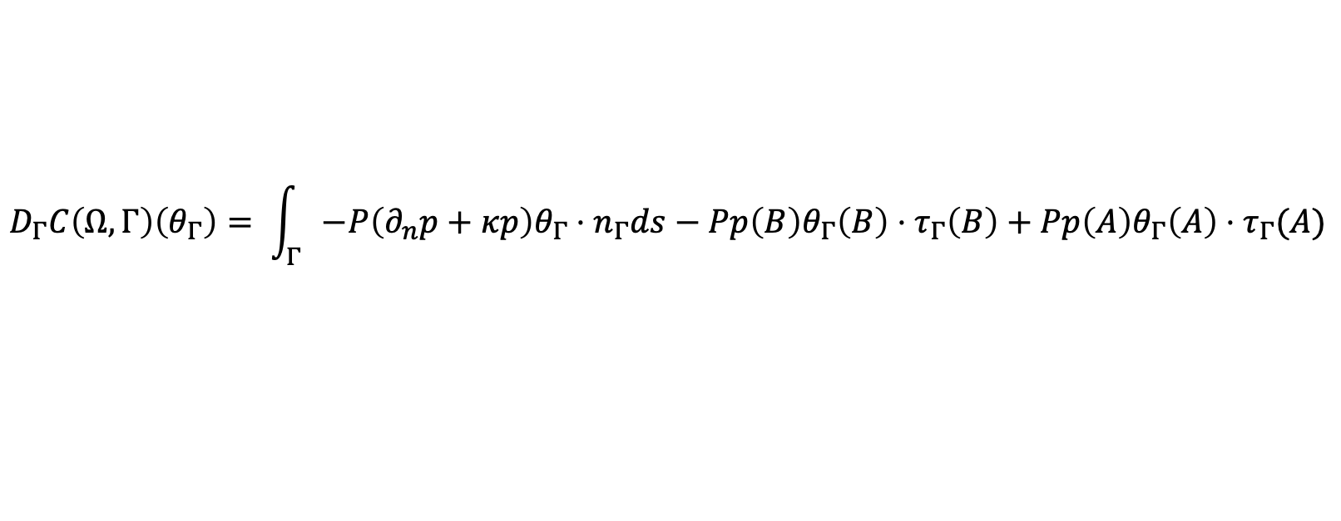

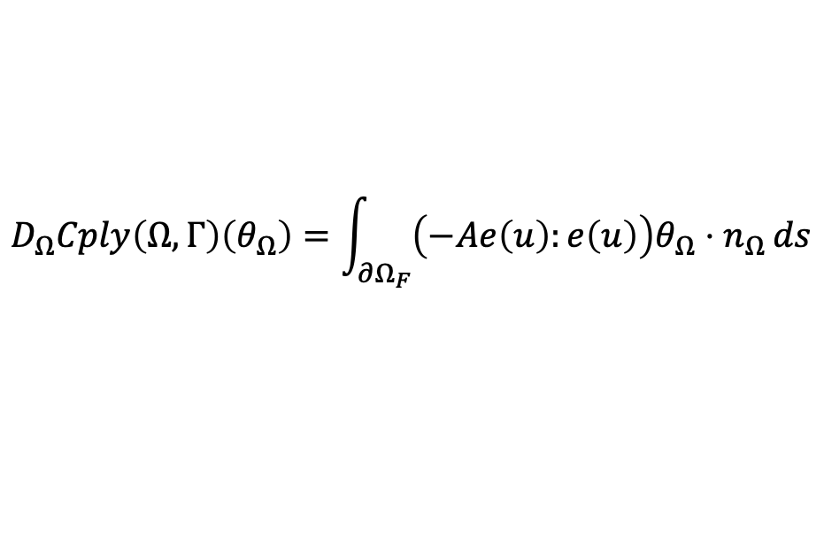
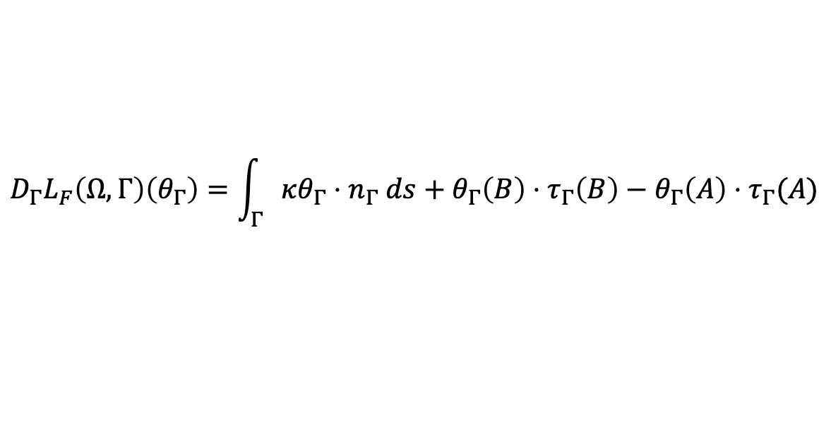



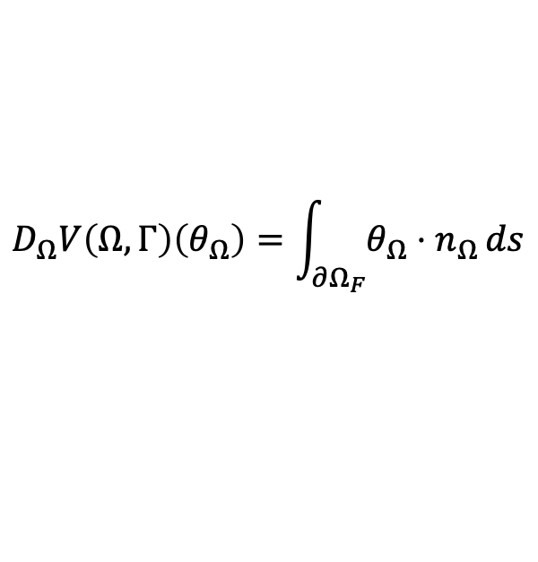





Derivatives with respect to the shape and path
$$D_{Ω}Cply\left(Ω,Γ\right)\left(θ_{Ω}\right)=\int_{∂Ω_{F}}{\left(−Ae\left(u\right):e\left(u\right)\right)θ_{Ω}⋅n_{Ω}}ds$$
$$D_{Ω}L_{F}\left(Ω,Γ\right)\left(θ_{Ω}\right)=0$$
$$D_{Ω}V\left(Ω,Γ\right)\left(θ_{Ω}\right)=\int_{∂Ω_{F}}{θ_{Ω}⋅n_{Ω}}ds$$
$$D_{Ω}C\left(Ω,Γ\right)\left(θ_{Ω}\right)=\int_{∂Ω_{F}}{{\left({\left(y_{φ}−y\right)}^{+}+{\left(y−y_{M,D_{S}}\right)}^{+}−{\left(y−y_{M,D∖D_{S} }\right)}^{+}\right)θ}_{Ω}⋅n_{Ω}}ds$$
$$D_{Γ}L_{F}\left(Ω,Γ\right)\left(θ_{Γ}\right)=\int_{Γ}{κθ_{Γ}⋅n_{Γ} ds}+θ_{Γ}\left(B\right)⋅τ_{Γ}\left(B\right)−θ_{Γ}\left(A\right)⋅τ_{Γ}(A)$$
$$D_{Γ}Cply\left(Ω,Γ\right)\left(θ_{Γ}\right)=0$$
$$D_{Γ}V\left(Ω,Γ\right)\left(Ω,Γ\right)(θ_{Γ})=0$$
$$D_{Γ}C\left(Ω,Γ\right)\left(θ_{Γ}\right)= \int_{Γ}{−P\left(∂_{n}p+κp\right)θ_{Γ}⋅n_{Γ}ds}−Pp\left(B\right)θ_{Γ}\left(B\right)⋅τ_{Γ}\left(B\right)+Pp\left(A\right)θ_{Γ}\left(A\right)⋅τ_{Γ}(A)$$
$$\left\{\begin{aligned}−∇\left(λ∇p\right)+βp=2\left[{\left(y_{φ}−y\right)}^{+}𝕝_{D_{S}}−{\left(y−y_{M,in}\right)}^{+}𝕝_{D_{S}}−{\left(y−y_{M,out}\right)}^{+}𝕝_{{D∖D}_{S}}\right] \\ λ∂_{n}p=0\end{aligned}\right.$$
With $p∈H^{1}(D,ℝ^{2})$ solution of
$−∇\left(λ∇p\right)+βp=2\left[{\left(y_{φ}−y\right)}^{+}𝕝_{D_{S}}−{\left(y−y_{M,in}\right)}^{+}𝕝_{D_{S}}−{\left(y−y_{M,out}\right)}^{+}𝕝_{{D∖D}_{S}}\right]$,
$$x∈D$$
$λ∂_{n}p=0$,
$$x∈∂D$$
Notes:
Requires differentiation with respect to each variable

Slide 21
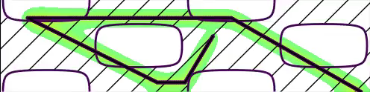

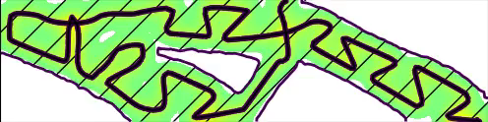
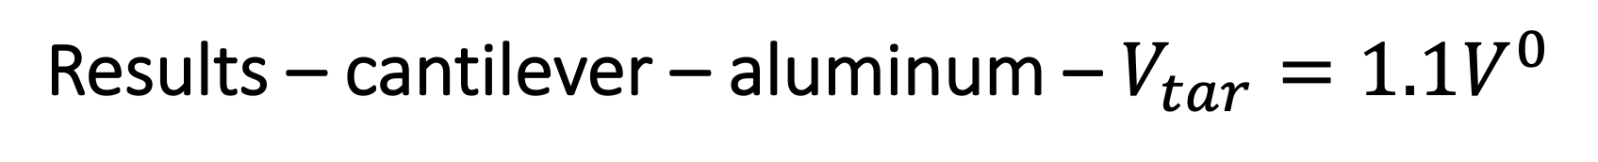
Results – cantilever – aluminum – $V_{tar}=1.1V^{0}$
INI
SONLY
Intuition of a link between part’s thickness and conductivity => Omega-shape path design
Boundary adaptation to the path
STEMP
SP-fromINI
PONLY
SP-fromPONLY

Slide 22
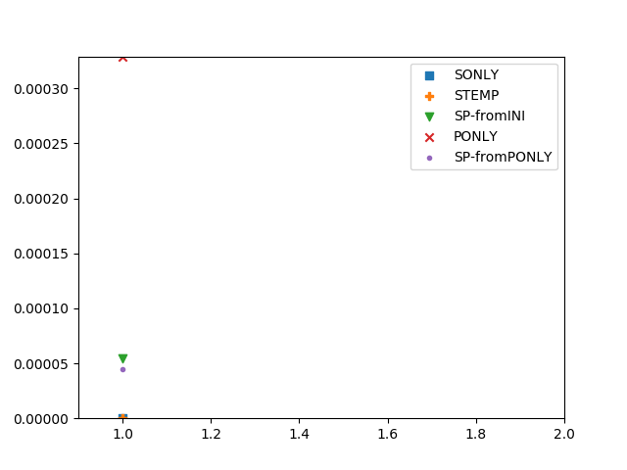
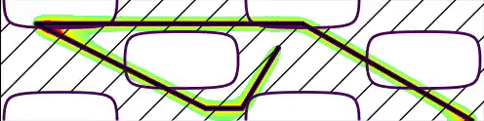
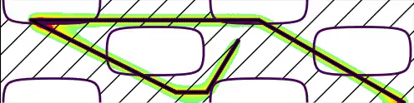
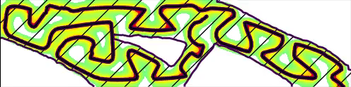
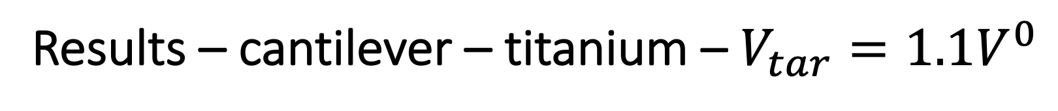
Results – cantilever – titanium – $V_{tar}=1.1V^{0}$
INI
SONLY
Intuition of a link between part’s thickness and conductivity => Omega-shape path design
=> Wave-shape path design
Boundary adaptation to the path
STEMP
SP-fromINI
PONLY
SP-fromPONLY

Slide 23
Conclusions and perspectives
Concurrent path and shape optimization
Confirms the importance of the link between thickness and conductivity
Boundary adapted to the path
Perspectives
Further test the optimization on other test cases, a complexified model
Include path topology modifications into the concurrent optimization
Adapt the constraint to reality: advantage the phase constraint, define “steady state” constraints modelling transient quantities (kinematics) to take benefit from the very easy resolution process and shape optimization theory
Optimize in the transient (general) model
Add the resolution of a mechanical problem (full resolution or inherent strain method)
3D considerations

Slide 24
References
References on which this talk is based on
M.Boissier, G.Allaire, C.Tournier, Additive Manufacturing Scanning Paths Optimization Using Shape Optimization Tools, SMO, 61:6, pp. 2437-2466 (2020)
M.Boissier, G.Allaire, C.Tournier, Concurrent shape optimization of the part and scanning path for additive manufacturing, submitted (2021). ⟨hal-03124075⟩.
M.Boissier, Coupling structural optimization and trajectory optimization methods in additive manufacturing, PhD thesis (2020)
Further reference for path optimization considering unsteadiness :
M.Boissier, G.Allaire, C.Tournier, Time dependent scanning path optimization for the powder bed fusion additive manufacturing process, submitted (2021). ⟨hal-03202102⟩.

Slide 25

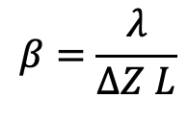
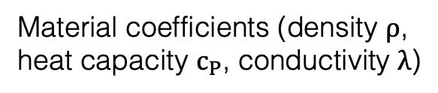

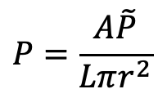
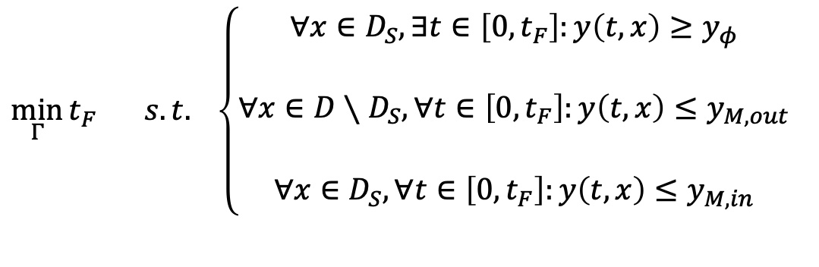
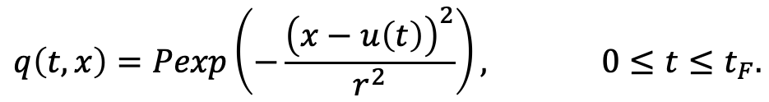





Two dimensional model
Macroscopic model
Thermal problem only
Temperature equation
No radiation nor convection
$ρc_{P}∂_{t}y(t,x)−∇⋅\left(λ∇y\left(t,x\right)\right)+β\left(y\left(t,x\right)−y_{ini}\right)=q(t,x)$,
$$\left\{\begin{aligned}cbk<xwn \\ <bcjkxc \\ \begin{matrix}xcjk<jxk \\ x<cjk\end{matrix}\end{aligned}\right.$$
$$\left(t,x\right)∈\left[0,t_{F}\right]×D$$
Adiabatic boundary conditions
(Neuman)
$λ∂_{n}y(t,x)=0$,
$$\left(t,x\right)∈\left[0,t_{F}\right]×∂D$$
$y(0,x)=y_{ini}(x)$,
$$x∈D$$
Gaussian source
Gaussian source
$$q\left(t,x\right)=Pexp\left(−\frac{{\left(x−u\left(t\right)\right)}^{2}}{r^{2}}\right), 0≤t≤t_{F}.$$
Material coefficients (density $ρ$,
heat capacity $c_{P}$, conductivity $λ$)
$$P=\frac{A\tilde{P}}{Lπr^{2}}$$
$$β=\frac{λ}{ΔZ L}$$
Two dimensional domain
$$L$$
Characteristic length
Constant source speed
$$\min_{Γ}{t_{F}} s.t. \left\{\begin{aligned}∀x∈D_{S}, ∃t∈\left[0,t_{F}\right]:y\left(t,x\right)≥y_{φ} \\ ndckn \\ ∀x∈D∖D_{S}, ∀t∈\left[0,t_{F}\right]:y\left(t,x\right)≤y_{M,out} \\ ncsjk \\ ∀x∈D_{S}, ∀t∈\left[0,t_{F}\right]:y\left(t,x\right)≤y_{M,in}\end{aligned}\right.$$
Notes:
Further simplifications than themacroscale modelling:
First, assumption that the residual stresses can be controlled by the temperature: get rid of mechanical problem, thermal problem only and constraint on the maximal temperature during the building
Then, thermal problem with Gaussian source centered at u following the path
Heat equation with conduction only. Because path belongs to source plane, further modelling by considering a two dimensional model where the conduction in the building direction (orthogonal to the layer plane) represented by temperature loss
Leads to an optimization problem: minimization of final time (or because vel constant, length) with temp const in DS and temp const out of DS
Model calibration to physically interpret the results

Slide 26
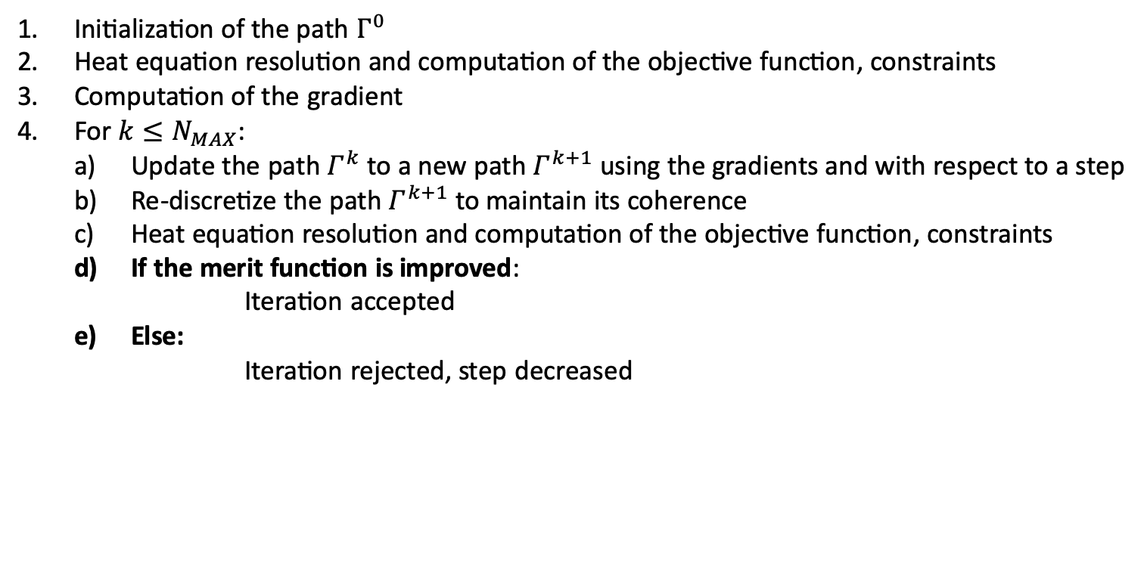
Numerical representation: front-tracking
Fixed physical mesh – Path described by a broken line defined by nodal points
Crucial points:
Control the broken line definition
Information mapping from the broken line to the physical mesh and vice versa
Initialization of the path $Γ^{0}$
Heat equation resolution and computation of the objective function, constraints
Computation of the gradient
For $k≤N_{MAX}$:
  Update the path $Γ^{k}$ to a new path $Γ^{k+1}$ using the gradients and with respect to a step
  Re-discretize the path $Γ^{k+1}$ to maintain its coherence
  Heat equation resolution and computation of the objective function, constraints
  If the merit function is improved:
    Iteration accepted
  Else:
  Iteration rejected, step decreased
Notes:
Last step is numerical computation
Choose a fixed physical mesh onto which are solved the temperature equations
Path is a broken line - > requires correct definition of the broken line at each iteration and information mapping from the broken line to the mesh and vice versa.
Finally optimization algorithm

Slide 27

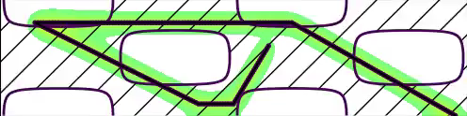

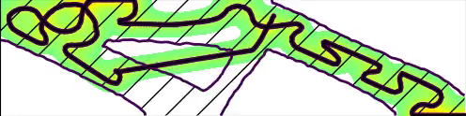
Results – cantilever – aluminum – $V_{tar}=0.9V^{0}$
INI
SONLY
Intuition of a link between part’s thickness and conductivity => Omega-shape path design
Boundary adaptation to the path
STEMP
SP-fromINI
PONLY
SP-fromPONLY
Notes:
Results
First initialization
Result from before: shape only without any path consideration
Then, shape only considering the thermal constraint -> thickness of the bars different from bifore
Then both
Then path only for Sonly: not able to cross the lines
Then both from Ponly: solve the hole crossing by cutting the hole into two parts and making one vanish

Slide 28
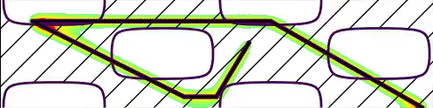
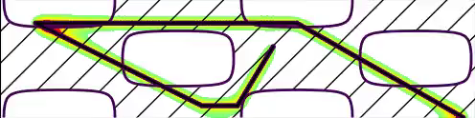
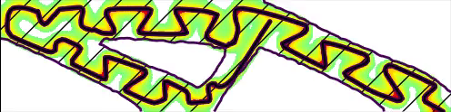
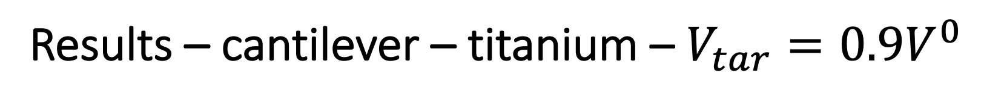
Results – cantilever – titanium – $V_{tar}=0.9V^{0}$
INI
SONLY
Intuition of a link between part’s thickness and conductivity => Omega-shape path design
Boundary adaptation to the path
STEMP
SP-fromINI
PONLY
SP-fromPONLY

